Slide 1

Hacker Factory Cyber Hackathon Solution
Team Name: Waves
Location: Bangalore

Slide 2
Team Information (Team Name and Participants details)
Team Name: Waves
Team Members:
Kartik Sharma (Employee ID: 468012)
Surabhi Chaudhary (Employee ID: 773039)

Slide 3
Cyber Security Topic: Preventive analytics with AI
Context:
Cops used to tap the calls they got from suspected persons or criminals. Whatever processing they do is to be done on the recorded call which consumes a lot of time. In the meantime, criminal can do some crimes. Furthermore, cops do not have any intel about the person and his crime records. If we reduce this time and make it happen in the real-time, cops will be able to get all the intel about the criminal they previously had and much crimes can be prevented.
Your understanding:
Its not difficult to get the voice data of the previously cached criminals. Also they must have maintained the criminal records of the previous criminals. All together, it will be serving as the database. This application will take the voice samples from the on going call and give the possible match of the criminal from the dataset. And cops will have all the relevant details about the caller if there is a good match. So cops can come up with better tactics to catch the caller before any crime occurs.
Scope of the solution covered:
This is a web application prototype which performs all the functionality mentioned but is less accurate due to very small dataset. Also, We are using microphone attached to pc instead of real voice call over cell phones.

Slide 4
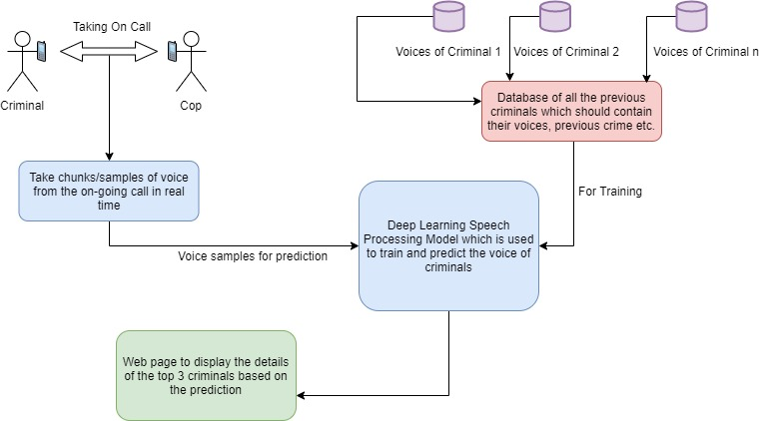
Solution Architecture / Design (What)

Slide 5
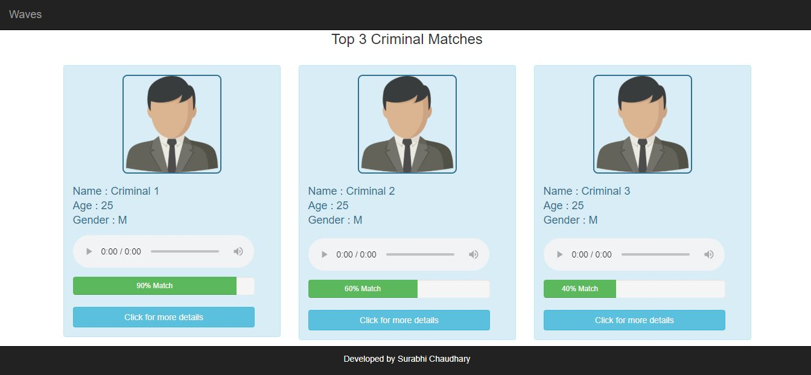
Screenshots

Slide 6
Additional Information – How can it enhance further
More Data, more accuracy and less crime
A multithreaded architecture can be implemented to make it more faster
More features can be implemented in the website like Face match

Slide 7
References
GitHub Link:
https://github.com/kartik173/Waves

